Slide 1

Dynamic Car Evacuation System: Intelligent Path Recalculation in Real Time
Revolutionising emergency response with adaptive navigation. This system integrates advanced algorithms and real-time visualisation to guide safe and efficient evacuations during critical incidents.
By :
231690 Aisha Zia
231696 M.Haider

Slide 2

The Challenge of Emergency Evacuations
Emergency situations like fires and severe traffic congestion create incredibly unpredictable and life-threatening evacuation scenarios.
Traditional, static evacuation routes are often insufficient, as they cannot adapt to rapidly changing hazards and dynamic traffic conditions.
Real-time, adaptive guidance is therefore critical to saving lives, minimising chaos, and ensuring the swift, safe movement of people away from danger zones.

Slide 3

Weighted A* Algorithm: Smarter Route Planning
Our system employs a sophisticated Weighted A* algorithm, a heuristic-driven search method designed to find optimal paths with exceptional efficiency.
Heuristic Search
Dynamic Weighting
Utilises intelligent heuristics to guide the search, significantly improving performance over traditional pathfinding.
Incorporates dynamic weights that reflect current traffic congestion levels, ensuring routes avoid potential bottlenecks.
Continuous Recalculation
Routes are continuously recalculated as conditions evolve, providing up-to-the-minute guidance and adapting to new obstacles.

Slide 4

Fuzzy Logic: Handling Uncertainty in Fire Hazards
To address the inherent uncertainties of fire incidents, our system integrates fuzzy logic, allowing for nuanced risk assessment.
Models Imprecise Conditions: Fuzzy logic effectively models imprecise and evolving fire spread and smoke conditions, providing a realistic understanding of the hazard.
Assigns Risk Levels: It assigns dynamic risk levels to individual road segments based on their proximity to the fire and the intensity of the blaze.
Integrates with A*: These risk levels are seamlessly integrated with the Weighted A* algorithm, dynamically steering evacuees away from increasingly dangerous zones.

Slide 5
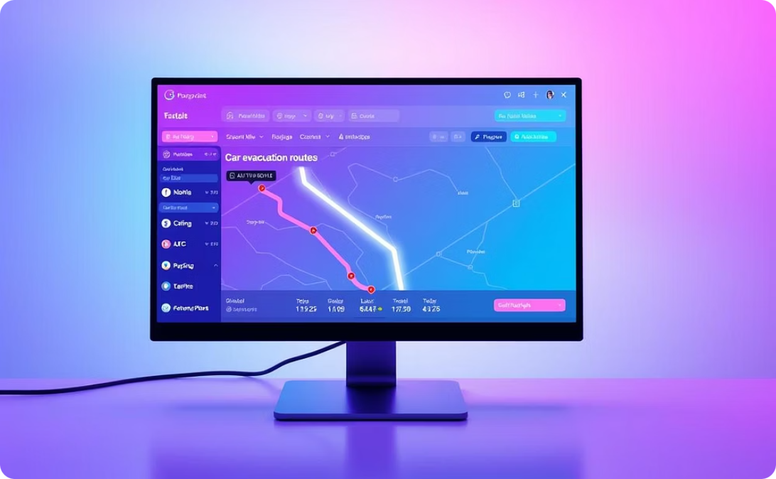


Real-Time Visualization with WPF Frontend
The system's Windows Presentation Foundation (WPF) frontend provides an intuitive and interactive user experience for both evacuees and emergency coordinators.
Interactive Map
Smooth Animations
Intuitive Interaction
A dynamic map displays current vehicle positions, hazard zones, and calculated evacuation routes in real time.
Route changes are visualised with smooth animations, making the rerouting process clear and easy to follow as conditions update.
The interface enables users to easily interpret complex data and interact with evacuation plans, fostering better decision-making.

Slide 6
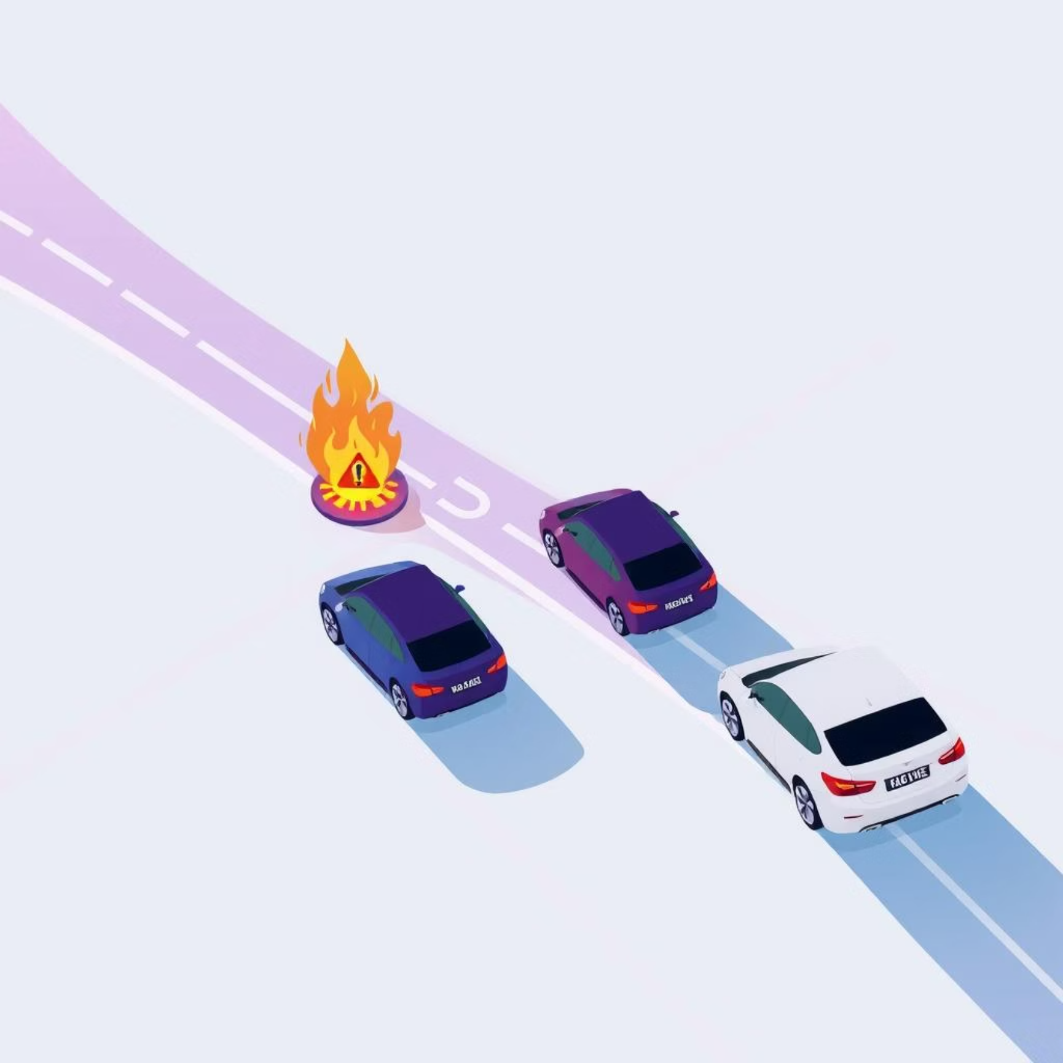
Case Study: Evacuation Under Spreading Fire and Traffic Jam
Consider a scenario where a sudden fire spreads onto a main evacuation road, simultaneously creating a significant traffic jam.
Initial Route Blocked: The system detects the fire and traffic, identifying the primary route as impassable.
Rapid Recalculation: Within seconds, the Weighted A* and fuzzy logic modules collaborate to calculate an alternative, safer path.
Optimal Rerouting: This new route avoids both the fire hazard and the heavy congestion, guiding vehicles through secondary roads.
Reduced Evacuation Time: This dynamic rerouting reduces overall evacuation time by an estimated 30%, saving crucial minutes in a crisis.

Slide 7




Technical Integration: From Data to Decision
The seamless operation of our system relies on robust technical integration, connecting data sources to intelligent decision-making modules.
Data Input
Traffic sensors and fire detection systems continuously feed live data into the core algorithm.
Backend Processing
Weighted A* and fuzzy logic modules run continuously on robust backend servers, processing data in real time.
WPF Frontend
The WPF frontend connects seamlessly, providing real-time user feedback, visualisation, and control.

Slide 8


Benefits and Impact
Our dynamic car evacuation system delivers significant benefits, transforming emergency management and enhancing public safety.
Enhanced Safety
Reduced Evacuation Time
Support for Responders
Dynamically avoids hazards and traffic jams, significantly reducing risks to evacuees.
Adaptive guidance minimises delays, ensuring quicker, more efficient evacuations and reducing panic.
Provides emergency services with actionable, up-to-date situational awareness and control.

Slide 9

Conclusion: Towards Smarter, Safer Evacuations
The integration of weighted A* algorithms and fuzzy logic creates a powerful, adaptive tool essential for modern emergency management.
This system represents a vital step forward in emergency management technology, promising a future where intelligent, interactive solutions safeguard lives.
Adaptive Power
1
Weighted A* and fuzzy logic for dynamic routing.
Clear Visualisation
2
Real-time WPF frontend for intuitive understanding.
Future Safety
3
Embracing intelligent solutions for enhanced protection.

